Slide 1





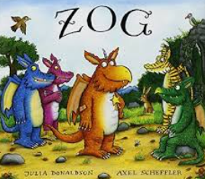


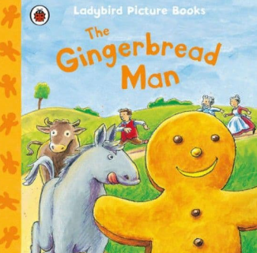
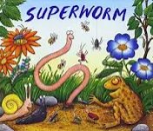



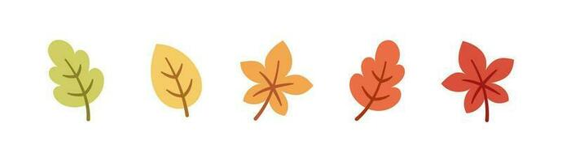
2 Year Olds
Medium Term Plan
Spring Term
Communication and Language
I can listen with interest to the noises adults make when they read stories
I show interest in play with sounds, songs and rhymes
I am beginning to understand more complex sentences, e.g. Hang you coat away and then sit on the carpet
I understands who, what, where in simple questions
I use language to share feelings, experiences and thoughts
I uses longer sentences (e.g. Mummy gonna work)
Physical Development
I can sit up from lying down or stand up from sitting.
I can squat with steadiness to rest or play with an object on the ground, and rise to my feet without using my hands
I am beginning to walk, run and climb on different levels and surfaces
I use wheeled toys with increasing skill such as pedalling, balancing and holding handlebars
I show increasing control in holding, using and manipulating a range of tools and objects such as tambourines, jugs, hammers, and mark making tools
I am able to feed myself independently
I am developing an increasing understanding bowel and bladder urges and I am starting to communicate my need for the toilet
I can support an adult with my self- care skills and I am becoming increasingly independent at putting on and taking off simple clothing items such as hats, unzipped jackets, wellington boots
Personal, Social and Emotional Development
I am beginning to separate from my carers and explore new situations with support and encouragement from another familiar adult
I seek out others to share experiences with and may choose to play with a familiar friend or child who has similar interests
I am beginning to think about my feelings and develop the connections that help me manage my emotions
I respond to the feelings of others, showing concern and offering comfort
I may recognise that some actions can hurt or harm others and I am beginning to stop myself from doing something I should not do
Enrichment
Jump in giant puddles
Play in the snow
Run through the forest school area

