Slide 1
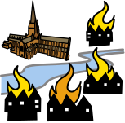
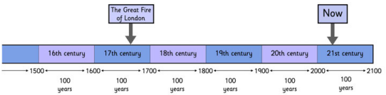



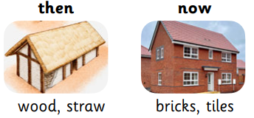
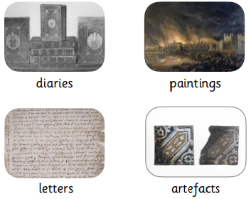
Year 1 and 2 Summer 1– History– Great Fire of London
Key knowledge to be taught:
The Great Fire of London started in a bakery in Pudding Lane.
The fire burned for almost five days; it was very hard to put out.
It destroyed one third of London.
Samuel Pepys kept a diary about the events of the Great Fire.
London was rebuilt after the fire..
Key vocabulary::
London
Samuel Pepys
Christopher Wren
Diary
Eyewitness
Source
Firebreak
Flammable
Devastation
Bakery
Pulley
Mechanism
Inferno
Destroyed
Parliament
Time / chronology
Understand the concepts of past, present, future, and use simple vocabulary to describe the passing of time.
Know that the further we go back in time, the more different life was.
Be able to locate time periods and place them on a timeline.
The Great Fire of London happened almost 400 years ago, which is beyond living memory.
The Great Fire of London took place in the 17th century in the year 1666. This was in the Stuart era, during the reign of King Charles II.
Everyday life – similarities and differences
Look at a theme a compare and contrast with. Today.
We can compare and contrast houses from the time of the Great Fire with houses now.
Building materials for houses:
.
Sources and evidence – historical evidence
Recognise the importance of real sources and evidence to help us understand events in the past.
Build a bugger picture of a historical period using a range of source material.
We can use these sources to find out about the Great Fire of London:
Historical Change including Local History
​​Know the importance of a significant individual in history and the reason for their fame.
​​
Samuel Pepys kept a diary about the events of the Great Fire.
Christopher Wren was an architect who rebuilt 52 churches in London after the Great Fire of London..
Linked texts:

