Slide 1
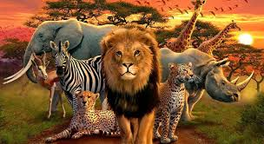
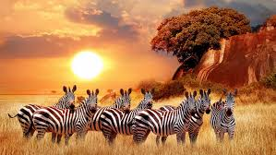
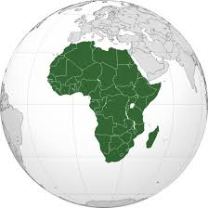
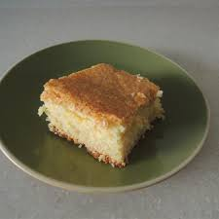

Year 1 and 2 topic homework – Around the amazing world (Autumn 1)
Your teacher will give you weekly homework and check that this has been completed. If you want to get a bit more creative,
here’s some ideas. Bring them in when completed and we’ll showcase them on our dojo and ‘X’ accounts.
Be a researcher
1. Make a collage using pictures
from holiday brochures or the
internet showing interesting
place to visit in Africa.
Be a presenter
2. Find out about different
animals that live in Africa. Present
your work in an exciting way!
Be a designer
3. Design and make a traditional
African pattern. Think carefully
about the colours you will use.
Be a creator
4. Find out about a traditional African dish or food and bring a picture of it. Even better try some
traditional cooking!

