Slide 1
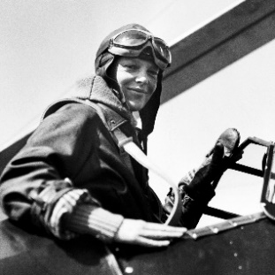
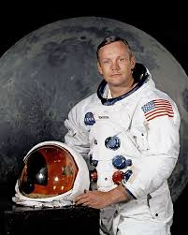
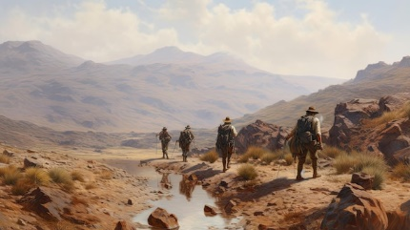
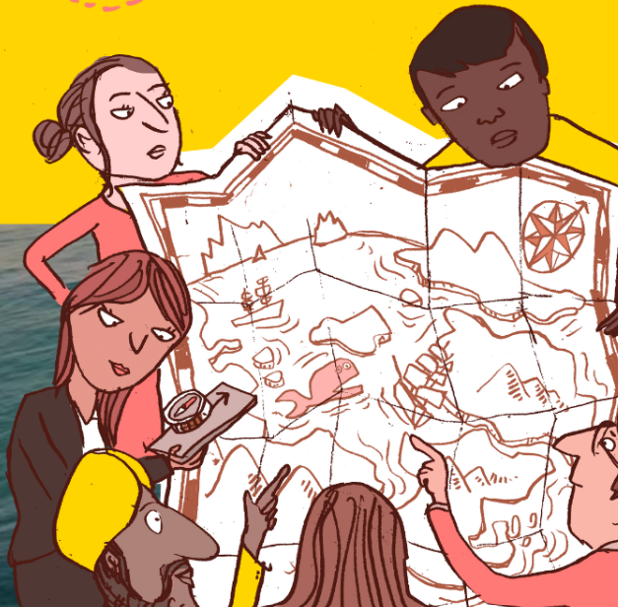
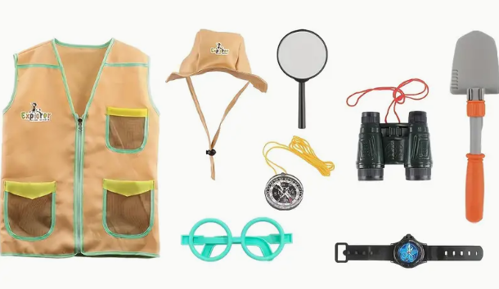
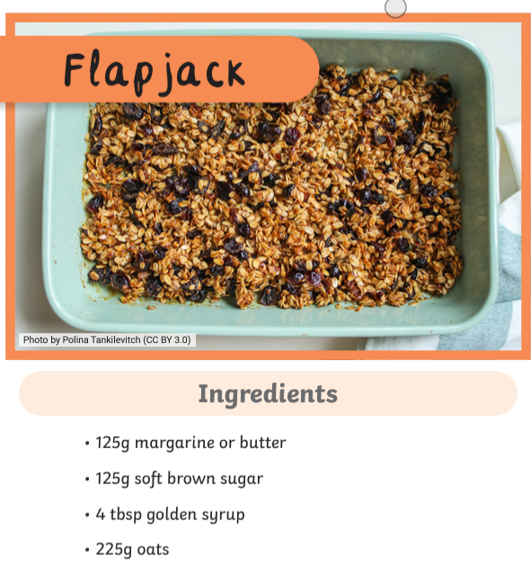
Year 1 and 2 topic homework – Great Explorers (Autumn 2)
Your teacher will give you weekly homework and check that this has been completed. If you want to get a bit more creative,
here’s some ideas. Bring them in when completed and we’ll showcase them on our Dojo and ‘X’ accounts.
Be a researcher
1. Make a collage using pictures
from holiday brochures or the
internet showing a place that you
would like to have discovered.
Be a presenter
2. Find out about an explorer from the past. Present your work in an exciting way!
Be a designer
3. Design an outfit for an explorer to wear. It could be a drawing, or you could use collage using fabric!
Be a creator
4. Create a snack that an explorer might take with them on an adventure. Bring in a picture of it.

