Slide 1
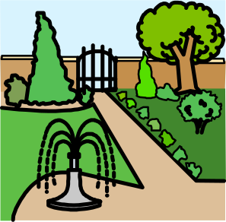
Year 1 and 2 topic homework – Wonderland (Spring 2)
Your teacher will give you weekly homework and check that this has been completed. If you want to get a bit more creative,
here’s some ideas. Bring them in when completed and we’ll showcase them on our dojo and ‘X’ accounts.
Be a researcher
Fact Finder
Find out three interesting facts about Arboretum Park or Arboretum Primary School. You might want to ask a family member, look online, or visit the park yourself! Write your facts in full sentences and include a picture or drawing.
Be a presenter
2. Be a local tour guide
Imagine you are a tour guide showing someone around Arboretum Park. Write a short speech or record a video introducing your favourite part of the park and why you like it.
Be a designer
3. Create a park
Imagine you are designing a new area in Arboretum Park. It could be a new playground, a nature trail, or a picnic area. Draw a picture of your design and write a few sentences to explain what it is and why people would enjoy it.
Be a creator
4. Make and prepare a local-inspired dish.
Make or design a meal inspired by our local area. You could create a sandwich, snack, or simple dish using ingredients that might be found in local shops. Draw a picture or take a photo and write a sentence about why you chose it.

