Slide 1


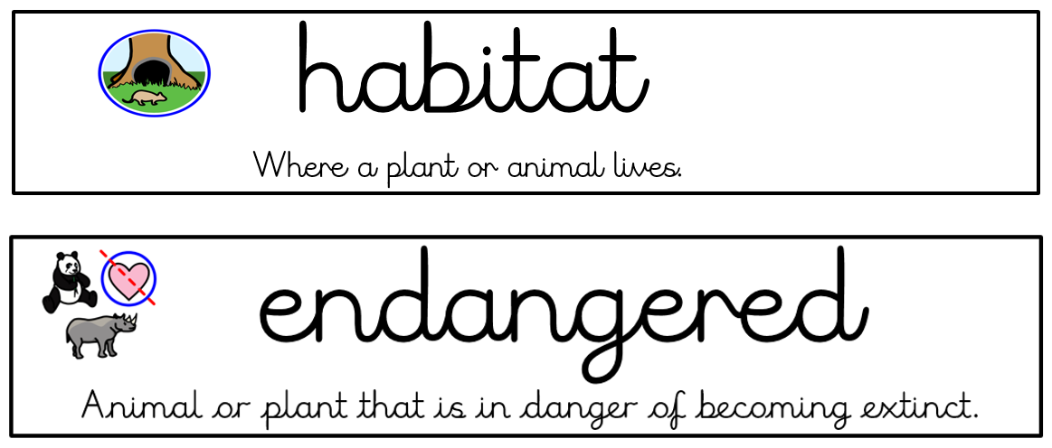
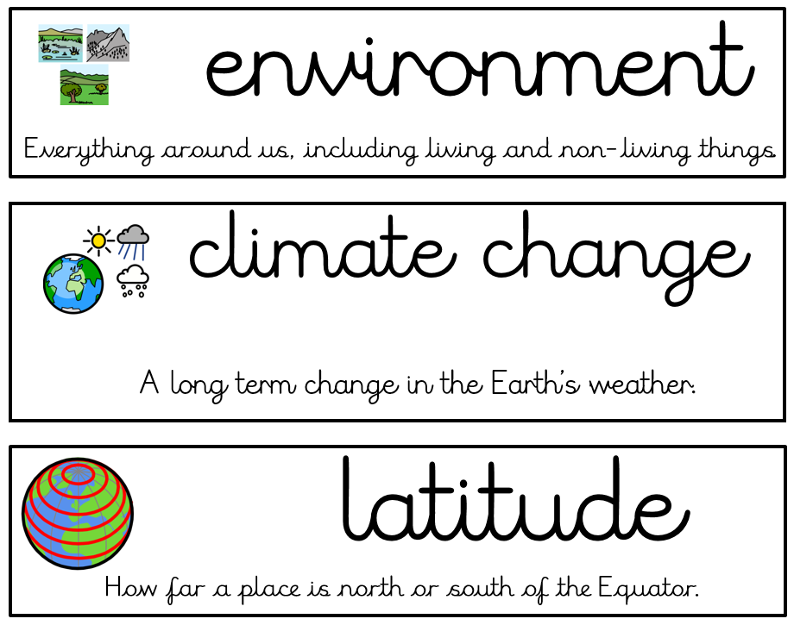




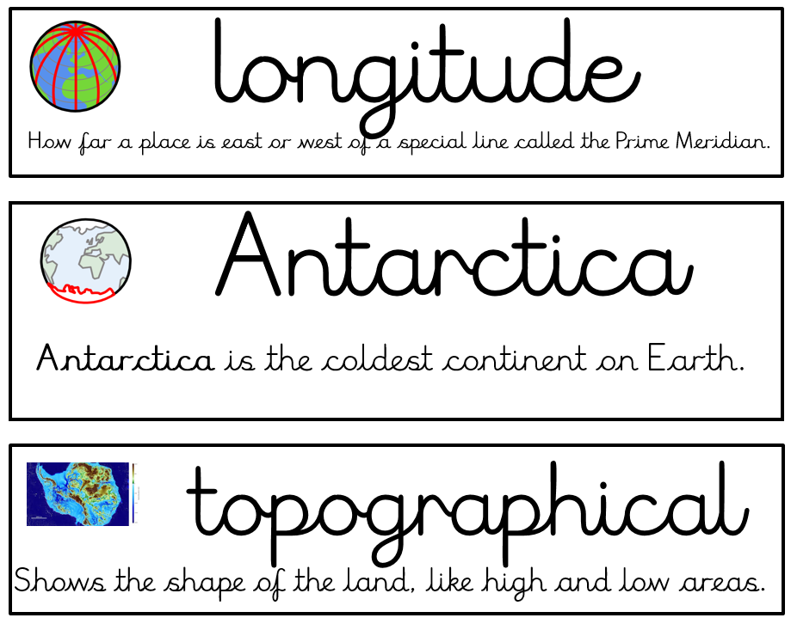
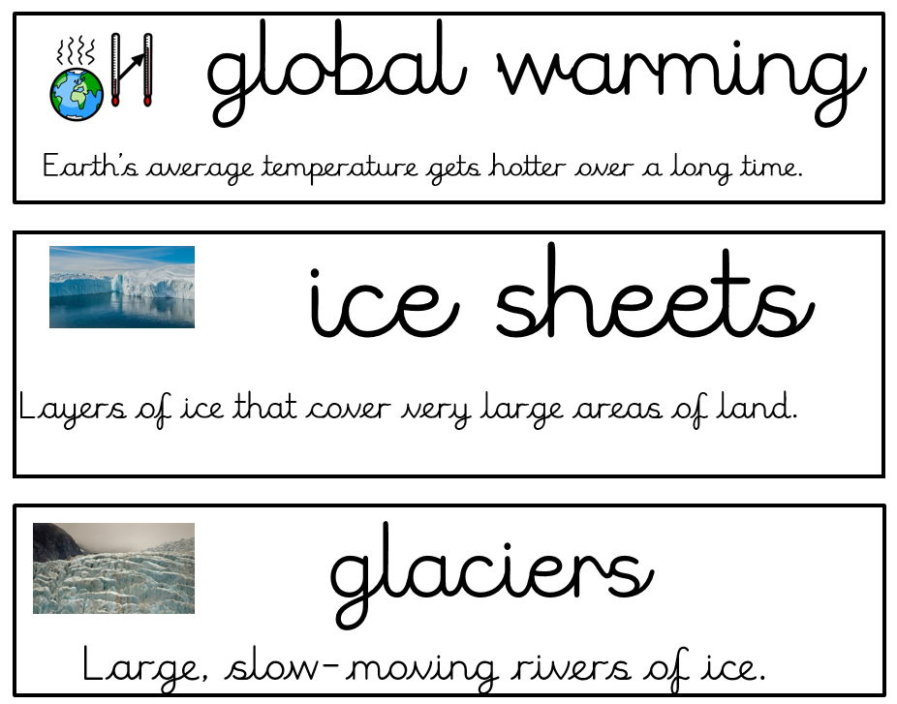


Topic (Geography) -Year 5 and 6 – Extreme Environments
Linked texts:
Girl of Ink and Stars – Kiran Millward Hargrave
Sky Song – Abi Elphinstone
Key knowledge to be taught:
Use lines of latitude and longitude to locate places.
Describe some of the key human and physical geographical features of the world.
Explain how climate changes at different lines of latitude.
Describe physical features of and locate deserts of the world.
Explain the water cycle and the importance of irrigation and water conservation schemes.
Explain how climate and natural resources influence human activity and economies.
Explain the effect of commercial and industrial activity on the environment and ways of improving it.
Key Vocabulary
Locational Knowledge
Name continents, oceans and key world cities ( London, Cairo, Sydney).
Place Knowledge
Discuss regions, characteristics and cities in Antarctica and the Sahara
Human and Physical Geography
Describe the physical features of the Polar regions.
Describe the physical features of a desert (Sahara, Gobi, Arabian).
Geography skills and fieldwork
Use maps, atlases, globes and computers to locate countries and describe their features.

